Slide 1

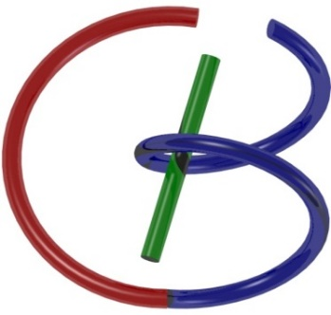
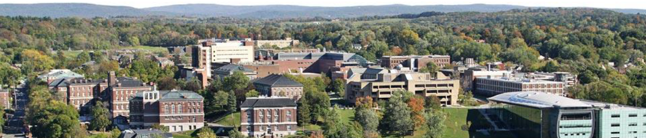
Midterm Review (Not Exclusive)
Ge Wang
AI-based X-ray Imaging System (AXIS) Lab
Rensselaer Polytechnic Institute, Troy, New York, USA
October 26, 2020

Slide 2
MI Schedule for F20
Tue | Topic | Fri | Topic
09/01 | Introduction | 09/04 | Neuron, Network & Backpropagation
09/08 | No Class | 09/11 | Hands-on 1: Python, Colab, & TensorF
09/15 | Architectures | 09/18 | Minds-on & Hands-on 2: MNIST Classification
09/22 | Image Quality I | 09/25 | CT Physics
09/29 | CT Reconstruction | 10/02 | Deep CT Reconstruction
10/06 | Hands-on 3: CT Networks | 10/09 | More CT Contents
10/13 | MRI Physics | 10/16 | Spin-Echo
10/20 | K-Space Theorem | 10/23 | More MRI Contents
10/26 | Midterm Review; 10/27 Mid Exam | 10/30 | Deep MRI Reconstruction
11/03 | Hands-on 4: MRI Networks | 11/06 | Nuclear Physics
11/10 | Nuclear Imaging | 11/13 | US Imaging
11/17 | Optical Imaging | 11/20 | Multimodality Imaging
11/24 | Hands-on 5: Image Conversion | 11/27 | Thanksgiving
12/01 | Image Quality II | 12/04 | Stability, Interpretability, & Others
12/08 | Overview | 12/11 | Final Exam

Slide 3
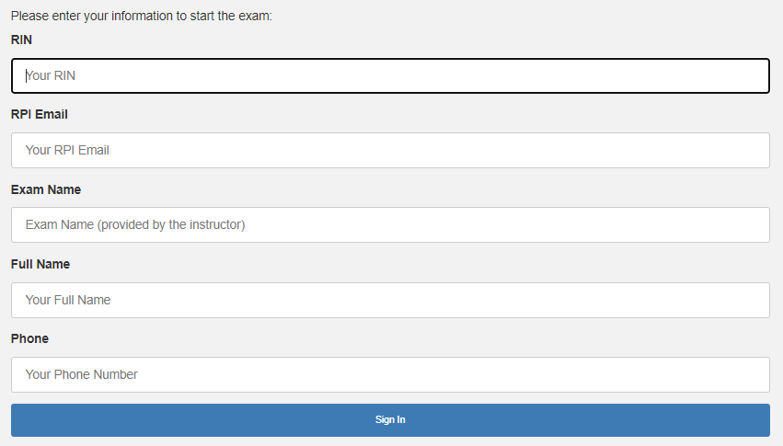
DOT URL: http://161.35.62.103.80/
F20MI-Midterm-DOT

Slide 4
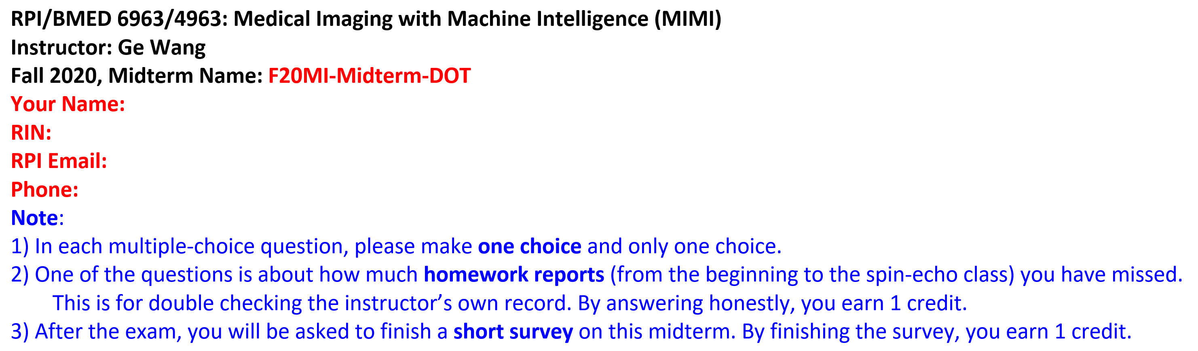
Notes

Slide 5
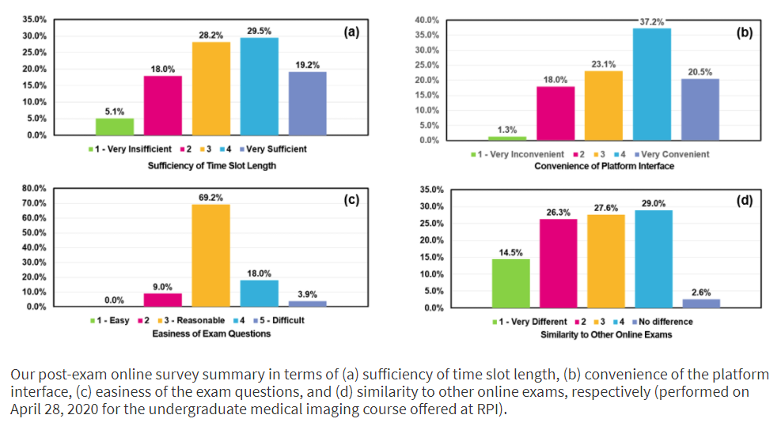
Survey Results in the Last Semester

Slide 6


Slide 7
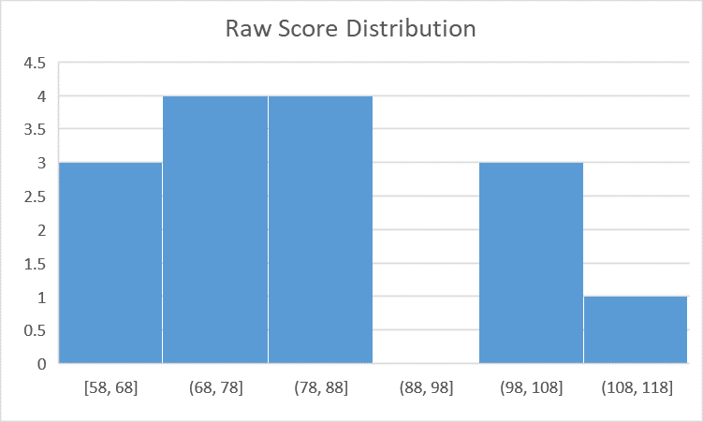
Midterm Distribution in Fall, 2018
C
B-
B
B+
A
A+

Slide 8
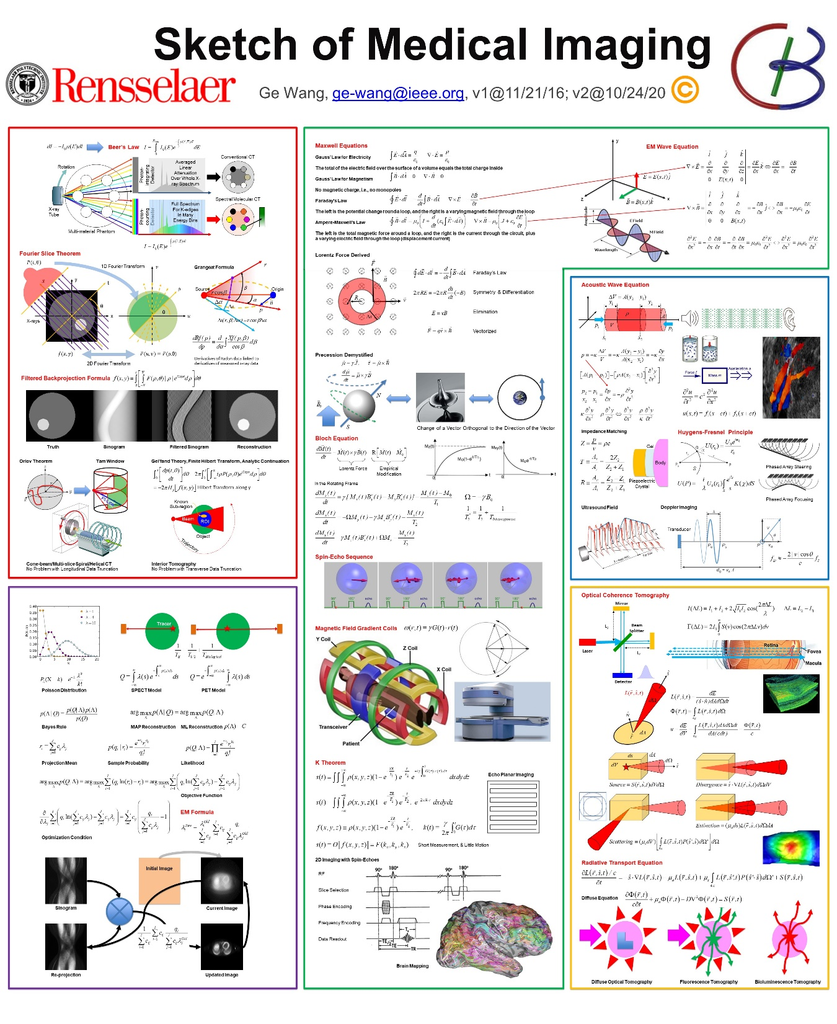

Slide 9
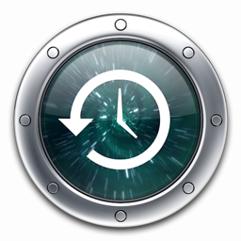
Outline
MRI
CT
NN

Slide 10
Signal Model with Gradients
Signal Model for a Whole Object in the lab frame
Spin-Echo Signal Model for a Whole Object with a 90˚ Pulse in the Rotating Frame
Relative to ω₀
Voxel-specific angular frequency in the inner product format
Voxel-specific accumulated phase factor
A trajectory point in the k-space after the volumetric integral at time instant t
Signal Model with Gradient Fields

Slide 11
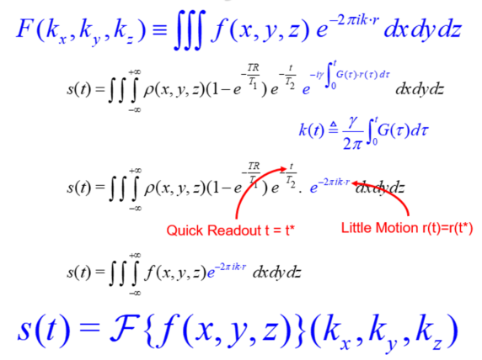
K-Theorem as the Foundation of MRI
This is the standard spin-echo signal model in the rotating frame for a whole object
This defines a “k” point as a function of time in the k-space, still in the rotating frame. Each k point is computed by integrating over the whole object space (the nature of FT)
The Fourier imaging model is again approximate, just like in the CT case
We need to let the “k” point trace the whole Fourier spectral support so that the inverse Fourier transform can be used to reconstruct the original image

Slide 12
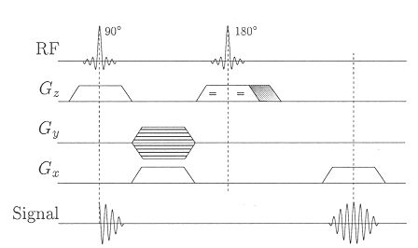
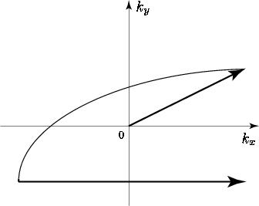
2D Spin-Echo
Dephasing from midpoint (Eq. (4.42) in BB
Rephasing
Ladder
=
=
t=0
t=TE/2
t=TE
Slice Selection Spin-Echo Reading

Slide 13
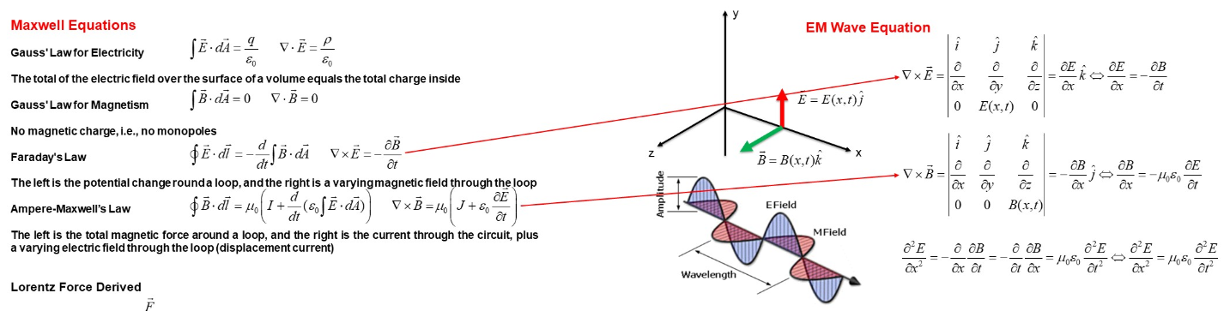
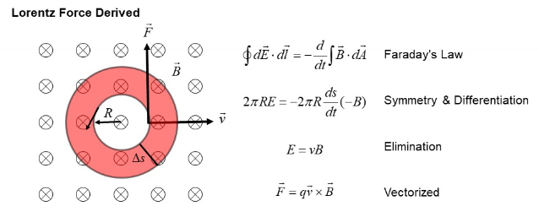
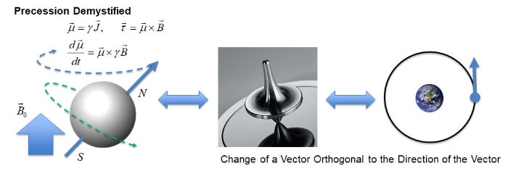

Slide 14
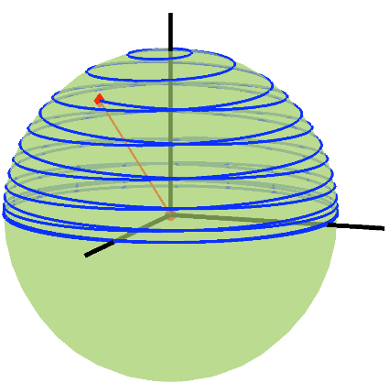
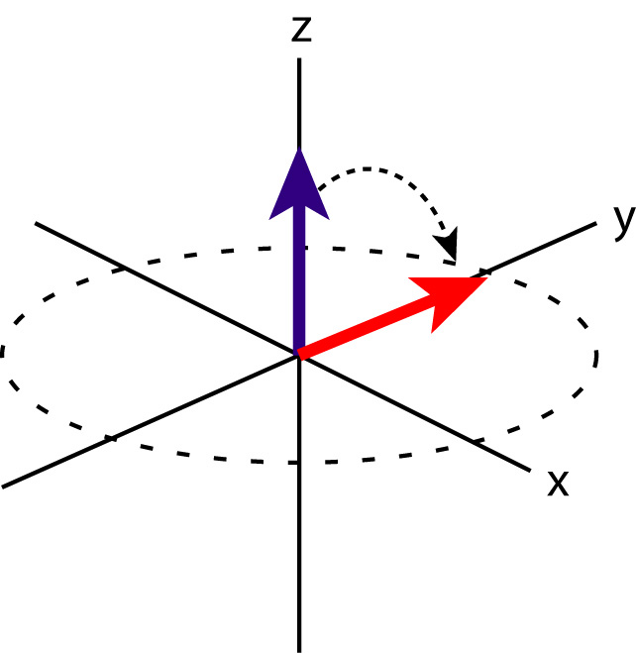
Bloch Eqs. in the Rotating Frame

Slide 15
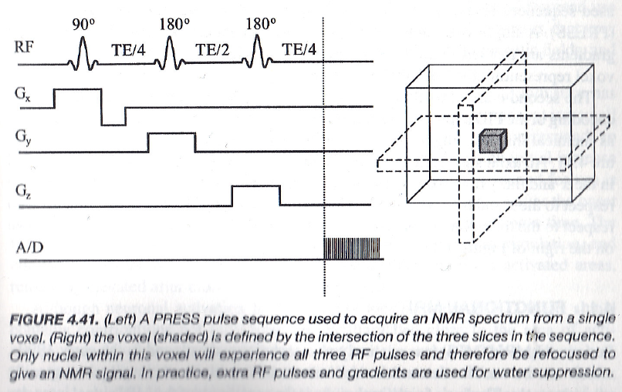
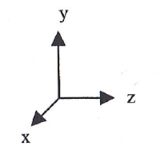
Spectroscopy Method: PRESS
(Point Resolved Spectroscopy)

Slide 16
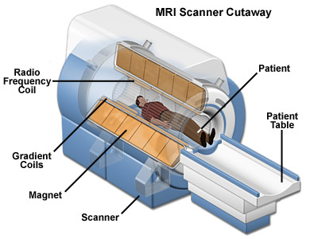
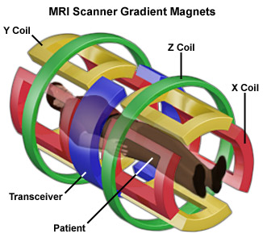
MRI System Diagram
https://nationalmaglab.org/education/magnet-academy/learn-the-basics/stories/mri-a-guided-tour

Slide 17
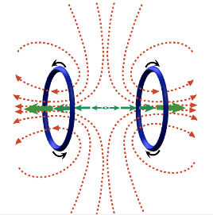
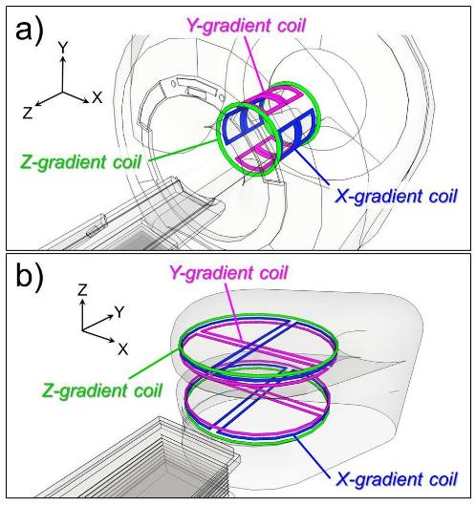

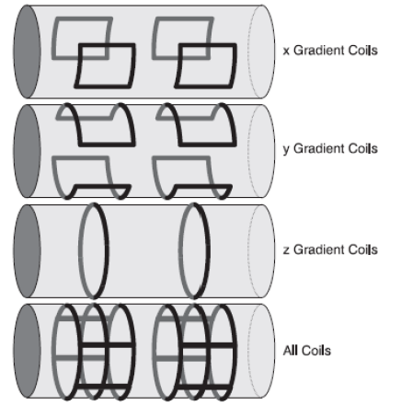
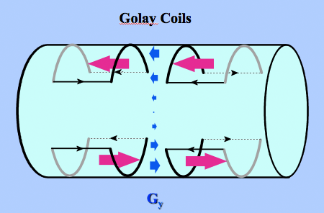
Gradient Coils
Longitudinal Gradient
Transverse Gradient

Slide 18
Outline
MRI
CT
NN

Slide 19
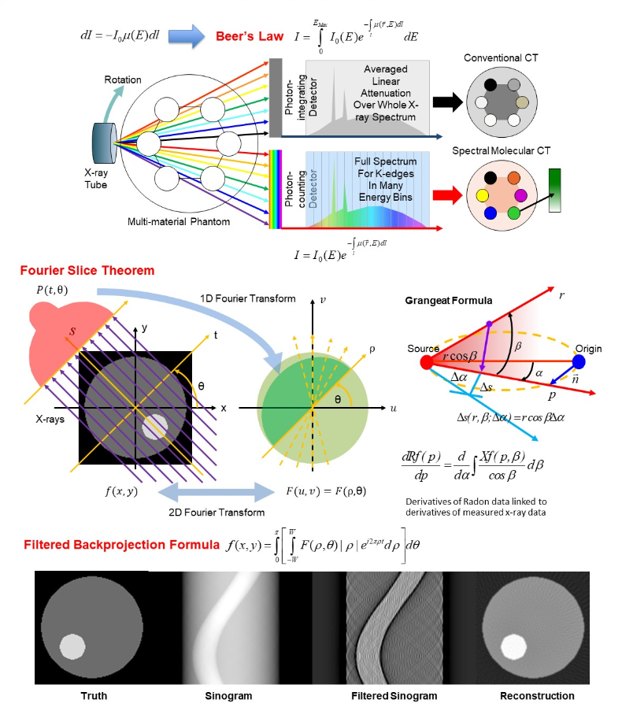
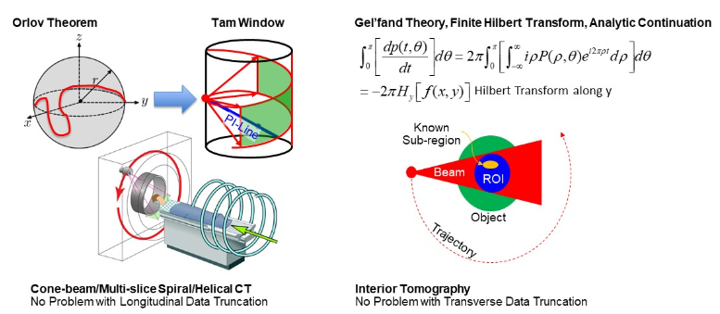

Slide 20
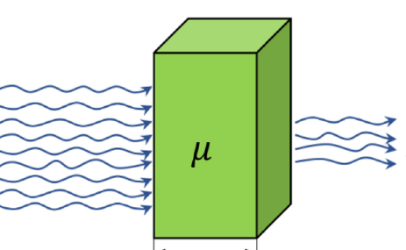
Derivation of Beer’s Law

Slide 21
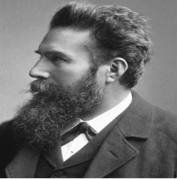
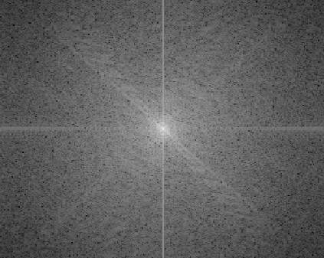

Sinusoidal Waves Are Building Blocks

Slide 22
Probing Waves
No any info in projection data along non-orthogonal directions
Info in projection data along the orthogonal direction

Slide 23

1D Fourier Slice
Radon Transform
1D Fourier Transform
X-rays
2D Fourier Transform

Slide 24
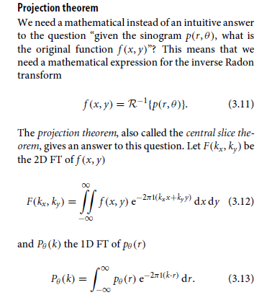
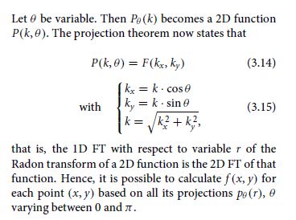
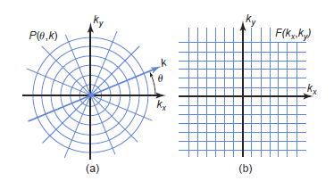
Fourier Slice Theorem

Slide 25
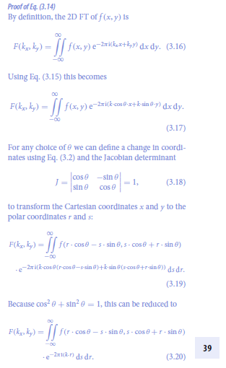
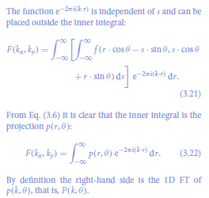

Slide 26
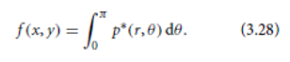
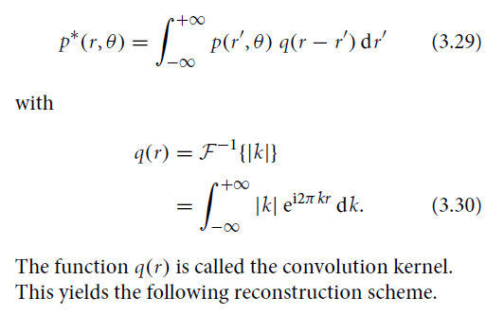
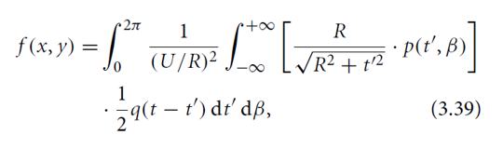
Parallel- to Fan-beam FBP
Parallel-beam
Filtered Backprojection
Key Idea: Convert Fan-beam Data to Parallel-beam Data or We Do It Heuristically!
Fan-beam
Filtered Backprojection

Slide 27
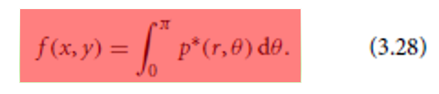
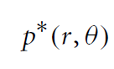
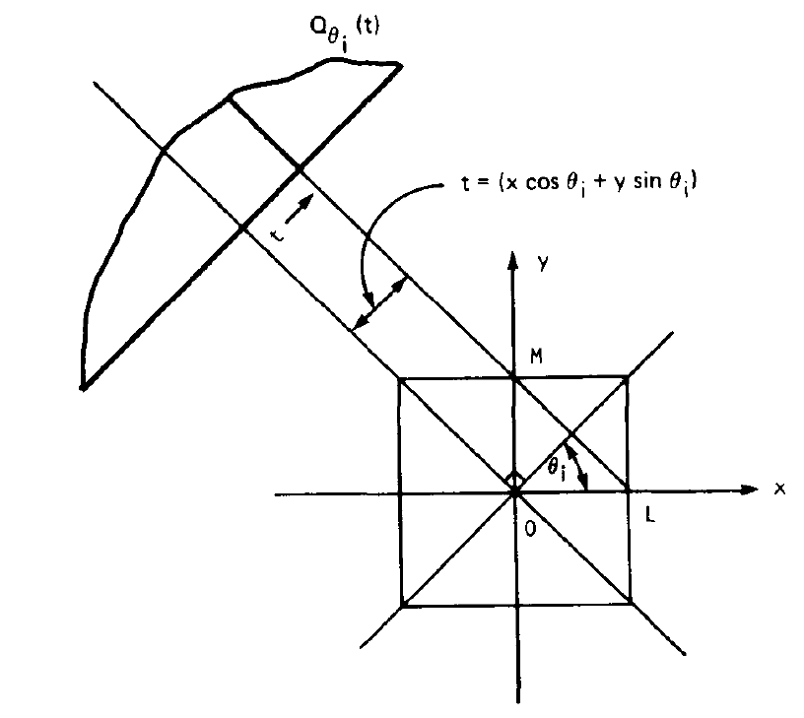

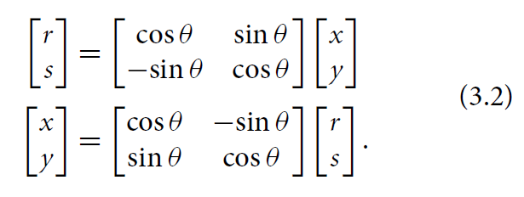
Backprojection from One Angle
Projection
r
r
r
r
r

Slide 28
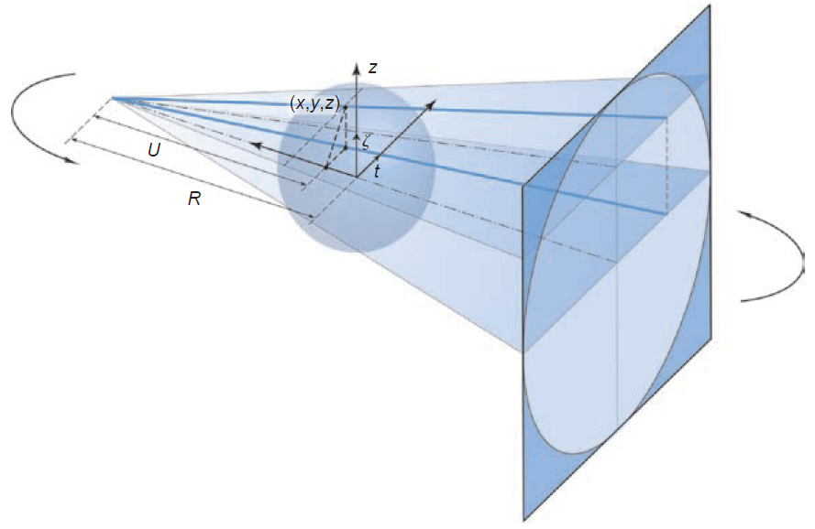
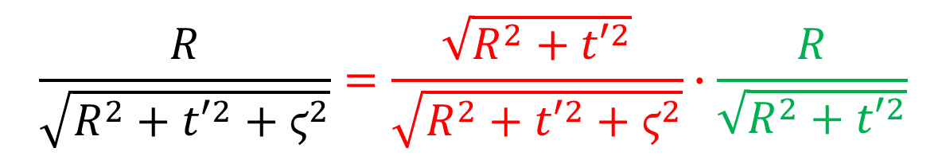
Cone-beam Scanning
α
β
General Scanning Trajectory
$$\frac{R}{\sqrt{R^{2}+{t′}^{2}+ϛ^{2}}}=\frac{\sqrt{R^{2}+{t′}^{2}}}{\sqrt{R^{2}+{t′}^{2}+ϛ^{2}}}∙\frac{R}{\sqrt{R^{2}+{t′}^{2}}}$$

Slide 29
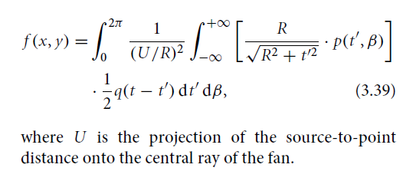
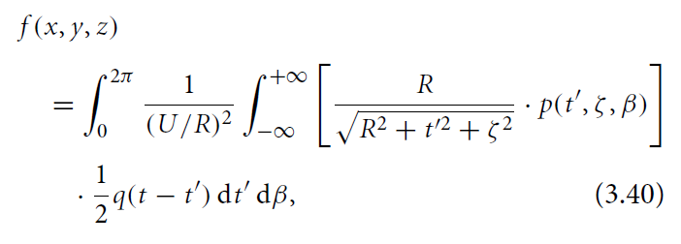
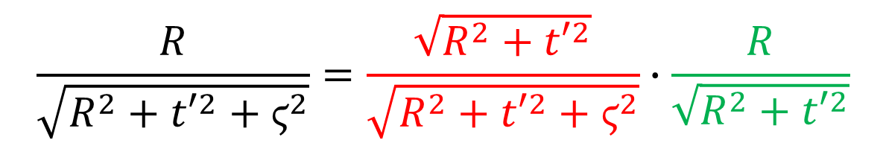
Obliqueness Correction
An X-ray Hits the 2D Detector Plate Obliquely, Determined by Two Angles
Obliqueness Correction in Fan-beam Formula
Obliqueness Correction in Cone-beam Formula
$$\frac{R}{\sqrt{R^{2}+{t′}^{2}+ϛ^{2}}}=\frac{\sqrt{R^{2}+{t′}^{2}}}{\sqrt{R^{2}+{t′}^{2}+ϛ^{2}}}∙\frac{R}{\sqrt{R^{2}+{t′}^{2}}}$$

Slide 30
Data Acquisition System (DAS)
Pre-Collimator
Post-Collimator
Source
Detector
Scattering
Filter
Patient

Slide 31
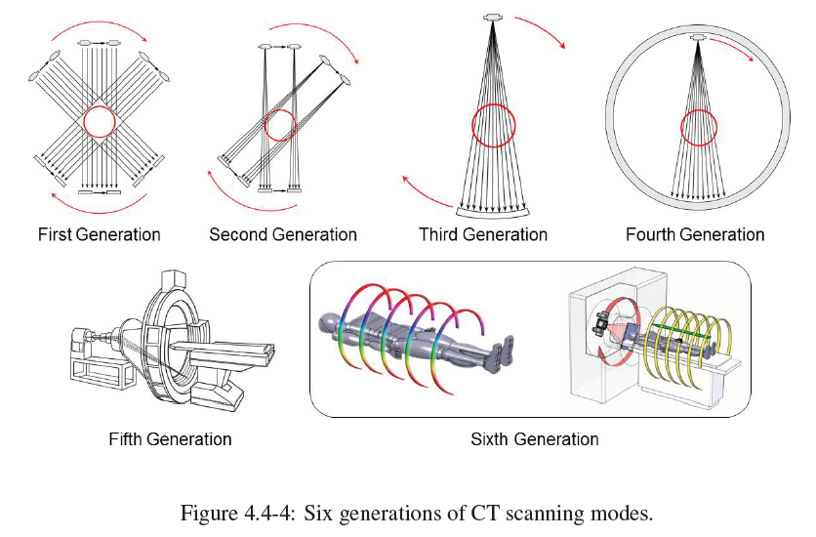
CT Scanning Modes

Slide 32
Outline
MRI
CT
NN

Slide 33
Biological & Artificial Neurons
Branches (Dendrite)
Body (Soma)
Interface (Synapsis)
Fiber (Axon)
Input
Output
Biological Neuron
Summation (Linear)
Weight
Transformation (Nonlinear)
Input
Output
Artificial Neuron

Slide 34

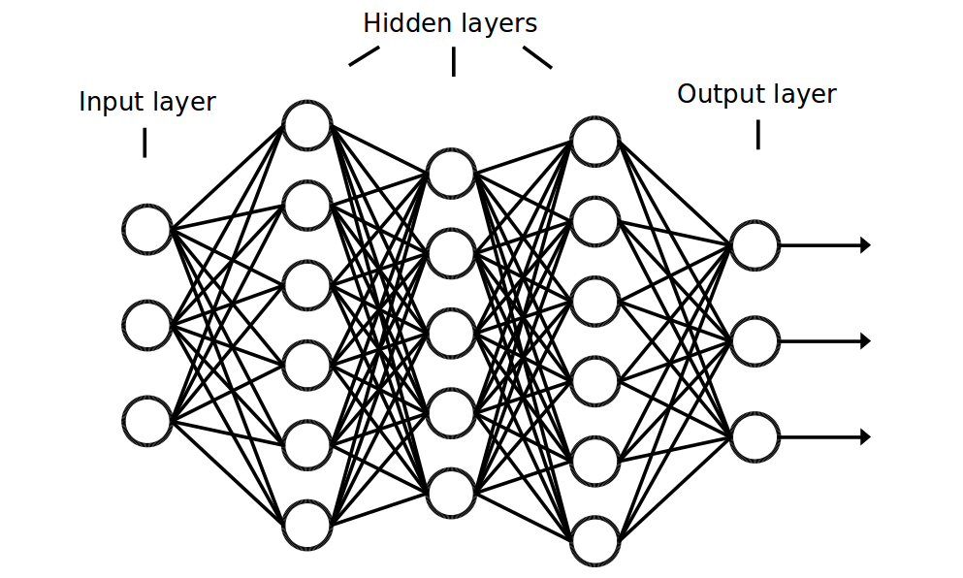
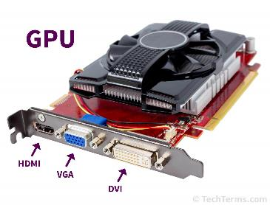
Programming vs Data-driven Learning
Data
Output
Program
Data
Output
Training
Data
Program
Output

Slide 35
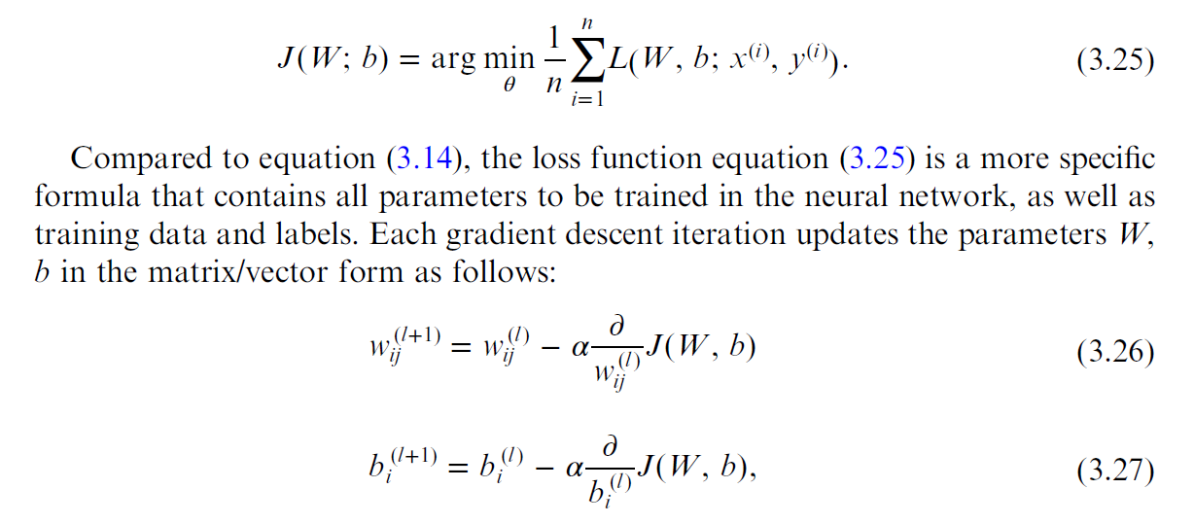
Backpropagation Algorithm (Book)
(3.17)

Slide 36

Single Layer Operation

Slide 37

Feed Forward 1-layer Network for 10 Classes
https://cloud.google.com/blog/products/gcp/learn-tensorflow-and-deep-learning-without-a-phd

Slide 38




Derivation of Softmax Function
These pseudo likelihood values are again in a relative sense!
Note -5, 7, -2 will make the denominator 0
These pseudo likelihood values are in a relative sense! –
We can set one as ground 0
Make sure non-negative
We can normalize these likelihood values to produce probabilities.
http://willwolf.io/2017/04/19/deriving-the-softmax-from-first-principles/

Slide 39

http://www.asimovinstitute.org/neural-network-zoo/

Slide 40

Convolutional Layer
https://stats.stackexchange.com/questions/142606/receptive-field-of-neurons-in-lenet

Slide 41

Recognizing Your Digits
Read an image file
Normalize it
Resize to
a desired size
Pass into the network

Slide 42


Auto-encoder
This is one of the greatest ideas in deep learning. If you explore more, you can create more advanced networks!

Slide 43

U-Net for Denoising & More

Slide 44





AUTOMAP with $O\left(N^{4}\right)$ Complexity
$O\left(N^{3}×N_{v}\right)$ Complexity
$N:$# of Data or Pixels per Row
$N_{v}:$# of views
Reshape
To a Vector
$$3×3$$
k-space Data
FC Layers to All Pixels
$3×3$ Image
Zhu B, Liu JZ, Cauley SF, Rosen BR, Rosen MS: Image reconstruction by domain-transform manifold learning. Nature 555:487–492, 2018
Notes:
In the literature, only a few deep-learning methods were proposed for reconstructing medical images directly from raw data. AUTOMAP, published last year on Nature, is the first work trying to learn the reconstruction process. N denotes the dimension of reconstructed image. AUTOMAP use 3 fully-connected layers to the the mapping between raw k-space data to a corresponding MRI images. The basic idea of AUTOMAP could be illustrated here. Due to the intrinsic relation between frequency domain and time domain, every pixel in k-space domain is related every pixel in image domain. Fully-connected layer is able to learn this relation. Without a doubt, similar idea could be applied to CT since sinograms and images are also correlated. If we directly apply AUTOMAP for CT applications, the complexity would be $O\left(N^{3}×N_{v}\right)$. N_v donotes the number of view. There are two problems if we use AUTOMAP for CT: 1. Due to the large computational complexity, AUTOMAP is not able to train normal size CT images on modern GPUs. In the AUTOMAP paper, authors used 128*128 images. 2. FC layers imply that all the pixels in both domain are correlated, but this is not the true for CT. In CT imaging, x-ray are used to take line integral at various angle, so a single point in the sinogram only relate to a line in the field of view.

Slide 45






iCTNet with $O\left(N^{2}×N_{c}\right)$ Complexity
FC
$3×3$ image
FC
$3×3$ final output
$4×3$ sinogram
$4α×3$ sinogram
$3×3$ image
*Li, Y., Li, K., Zhang, C., Montoya, J. and Chen, G., “Learning to Reconstruct Computed Tomography (CT) Images Directly from Sinogram Data under A Variety of Data Acquisition Conditions,” IEEE Transactions on Medical Imaging, 1–1 (2019).
Notes:
The second work trying to learn the reconstruction process is the iCTNet published on IEEE transaction on medical imaging this year. N_c denotes the number of detectors. The overall idea of iCTNet can be summarized here. Assume a CT scanner with 3 detectors and 4-view sinogram is acquired. iCTNet contains a total of 12 layers, in the first 8 layers, convolutional layers are used to de-noised sinogram, and to learn the interpolation process, generating a learned full-view sinogram with number of view $4α$, where$α$ is a hyperparameter in iCTNet. Then, instead of feeding the whole sinogram into one large FC layer, iCTNet feeds projection at each angle in to a small FC layer, thereby reducing the computation burden. Rotation operations are used to synthesis the analytical FBP method and then one convolutional layer is used to combine all the images at different angle, generating final output.

Slide 46

Our Key Idea: Smart BP with $O\left(N2\right)$ Complexity
Learned Filtered Projection
Smart Backpropagation with Learned Weights Restricted to a Single X-ray Path

Slide 47

Adversarial Learning
1.0
0.5
Frequency
Synthetic/
Source/Fake Distribution
Data/
Target/Real Distribution
Data

